Slide 1
Java Enviroment
Rajasekaran. S
Assistant Professor
Dept of IT

Slide 2
Java Enviroment
Setting up Java Enviroment for Development
in
Windows OS

Slide 3
Java Enviroment
Are you?
  Java Programs User?
    Only you need Java Runtime Enviroment [JRE].
    It contains sufficiant enviroment that can run java programs.
    But you can’t create your own java programs.

Slide 4
Java Enviroment
Java Developer
  You need Java Development Toolkit Pacakages [JDK].
  You need a good text editor like [Notepad, Notepad++].
  If your going work with a project then you can choose IDE’s like [Eclipse, Netbeans...].
  Download all your needs and be ready for set up.

Slide 5
JDK
It provides the environment to create and execute java programs.
JRE is included with JDK.
You can find lattest version of jdk in this link.
  http://www.oracle.com/technetwork/java/javase/downloads/index.html

Slide 6
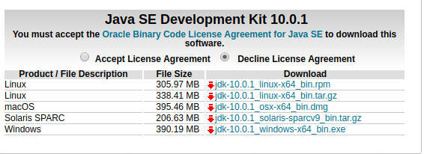
JDK and it’s variations

Slide 7
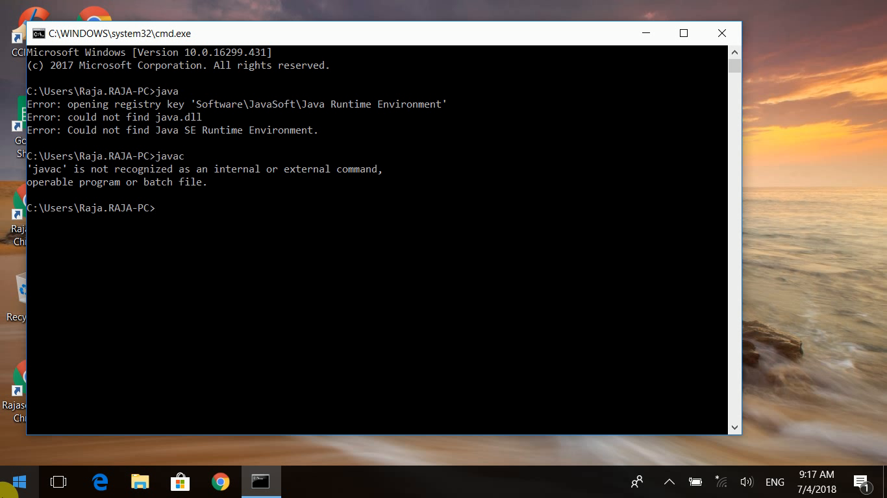
Checking for Java

Slide 8
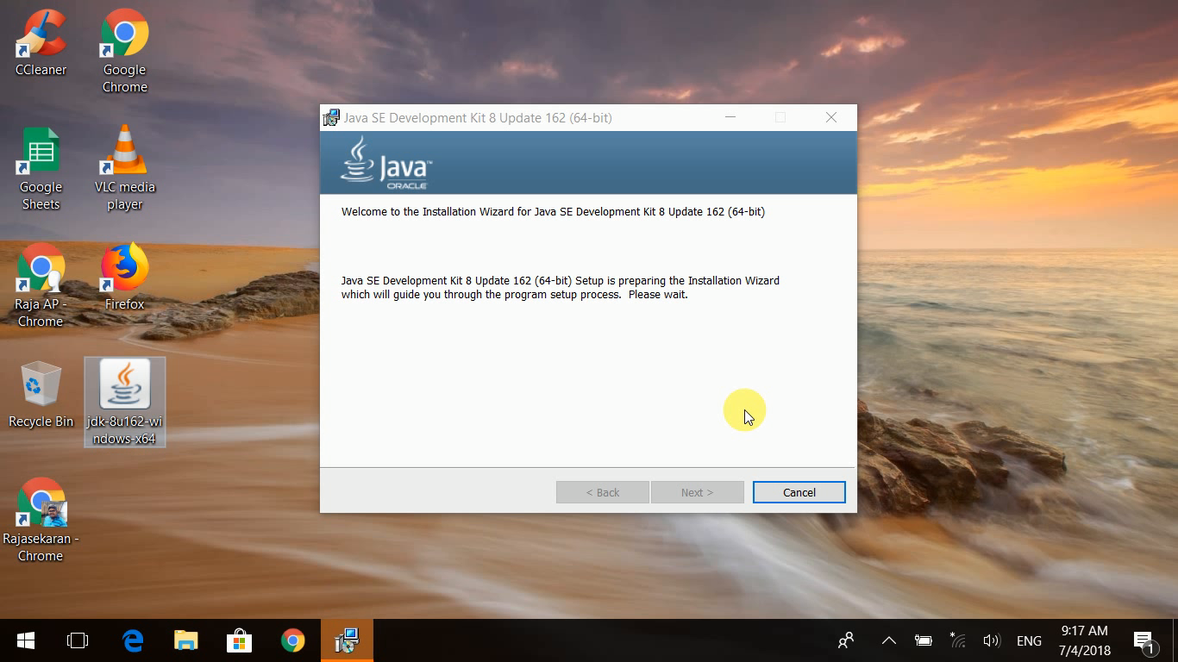
Installing Java

Slide 9
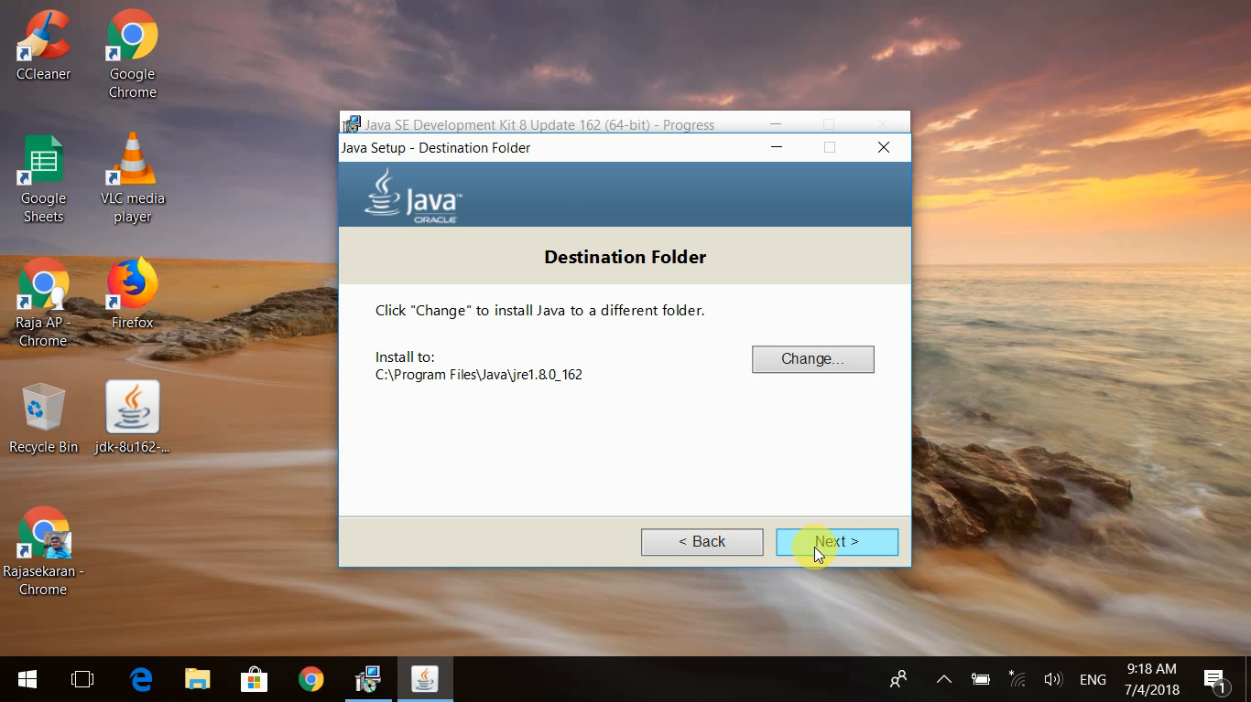
JRE Instalation

Slide 10
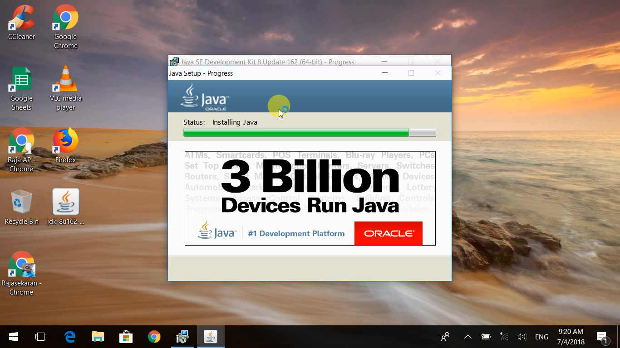
Installing

Slide 11
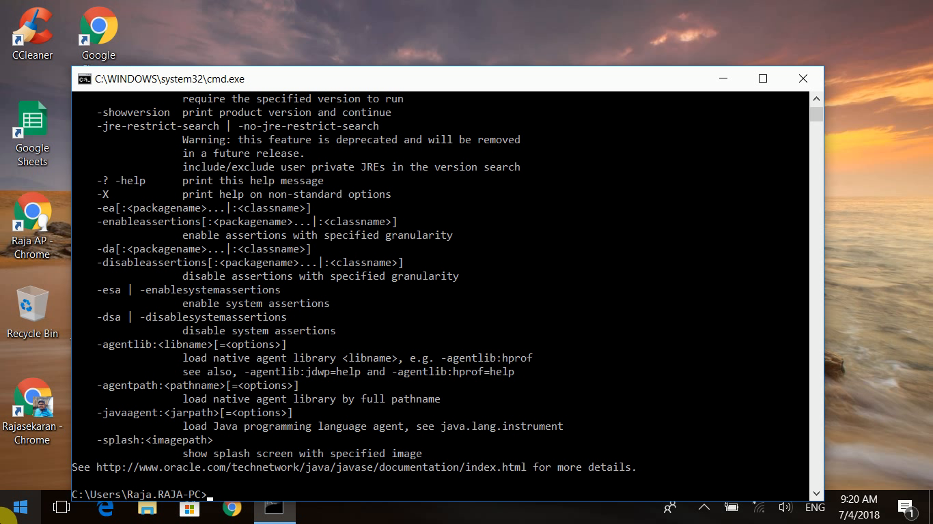
Java command working

Slide 12
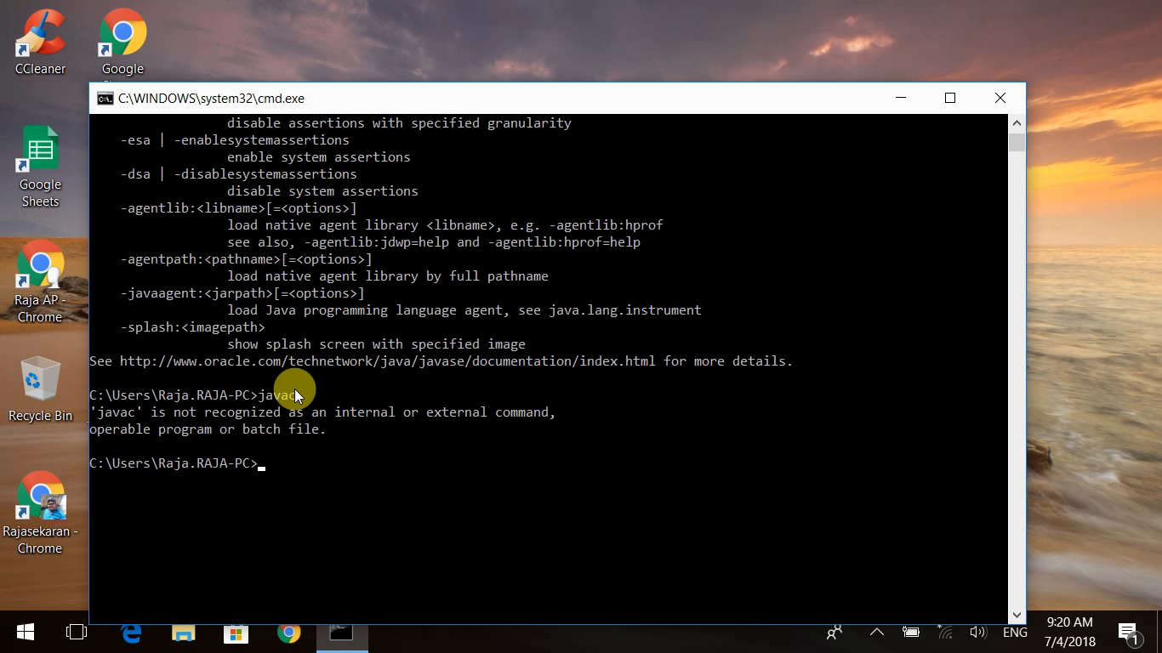
Javac not yet working

Slide 13
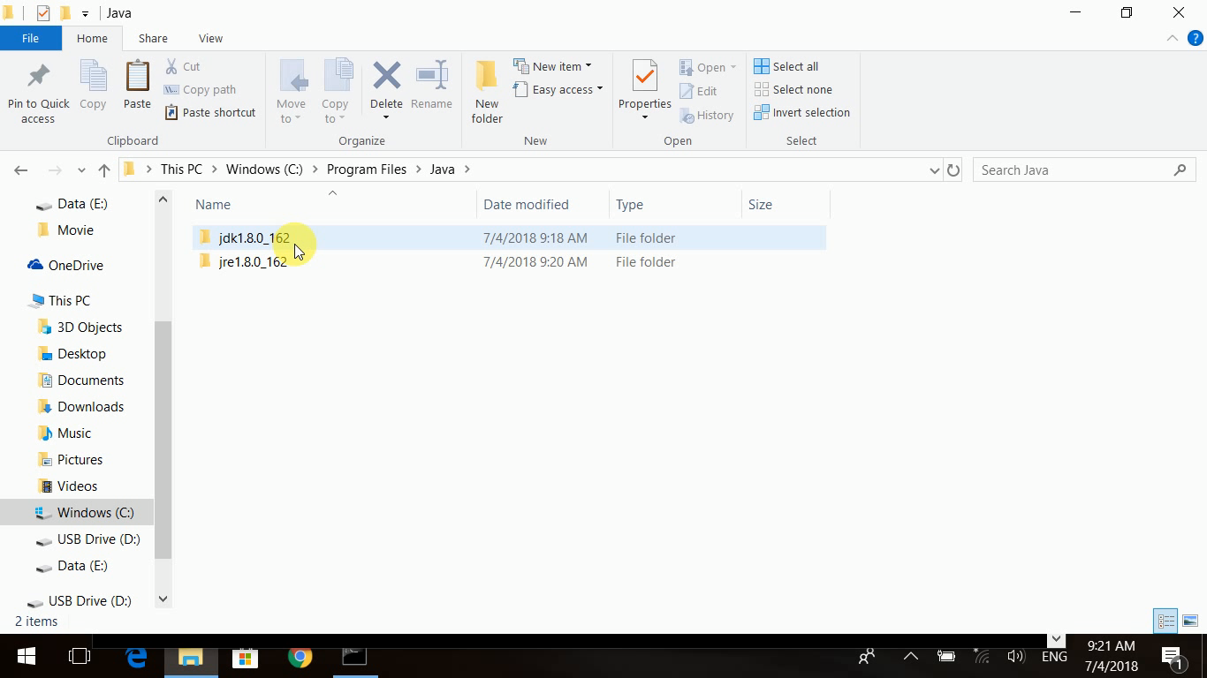
Jdk found but why javac not working

Slide 14
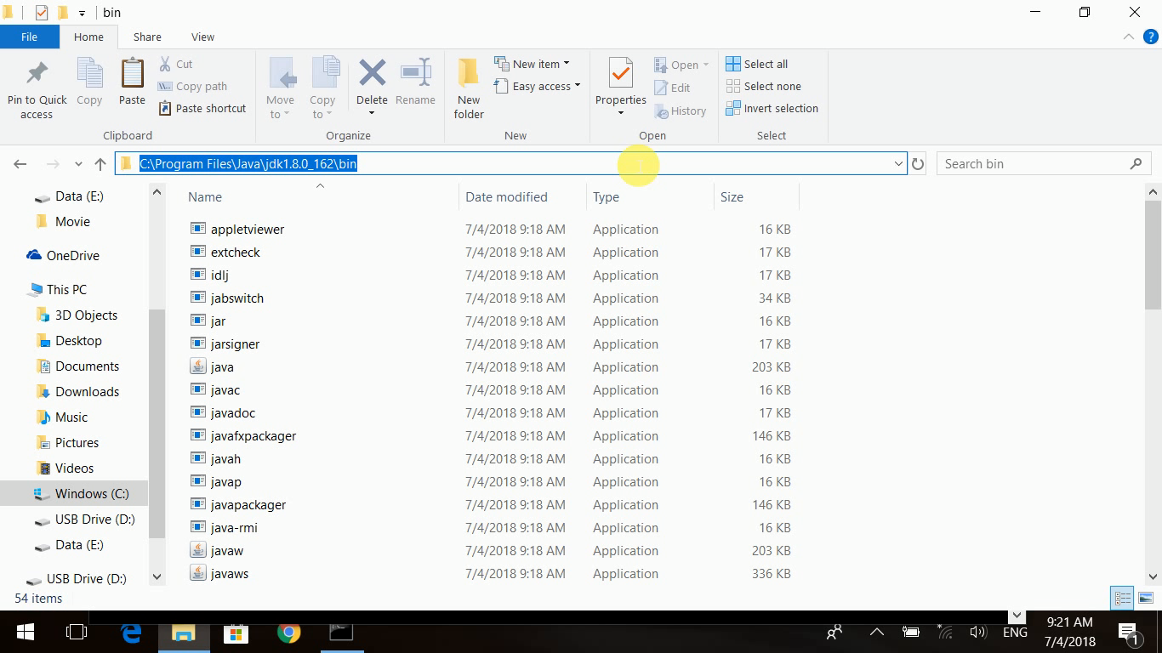
Copy Path

Slide 15
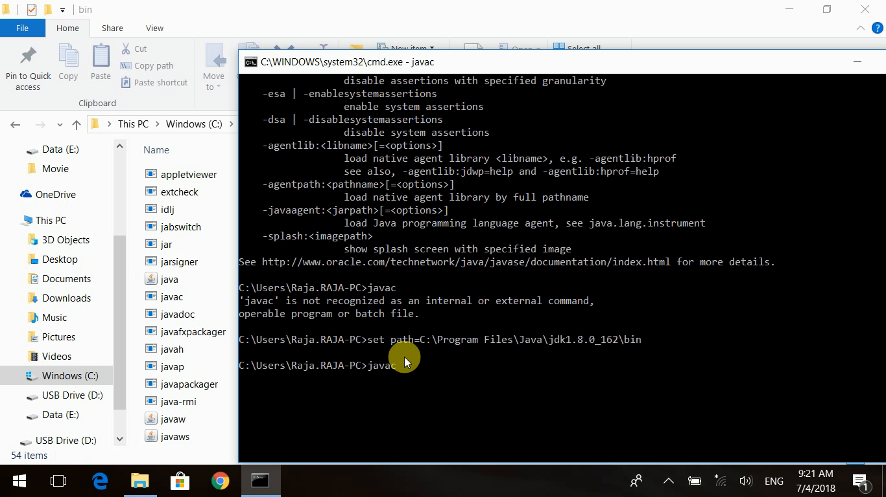
Do set path =“jdkpath”
set path=”C:\Program Files\Java\jdk1.8_162\bin”

Slide 16
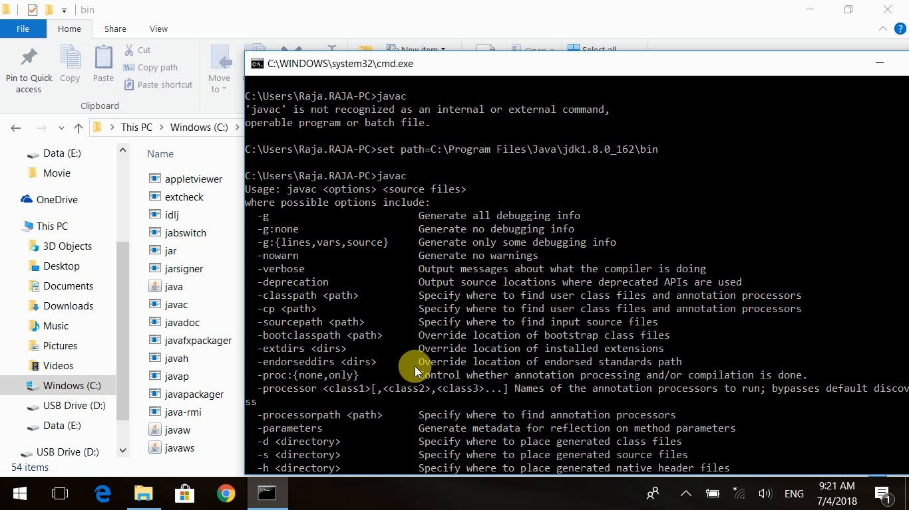
Now javac working

Slide 17
Limitations
You have to set a path every time cmd promt lanches.
This not confortable when you do rapid coding.
Let advise cmd promt to take care of javac commands.
For the we need to set enviroment variable java.

Slide 18
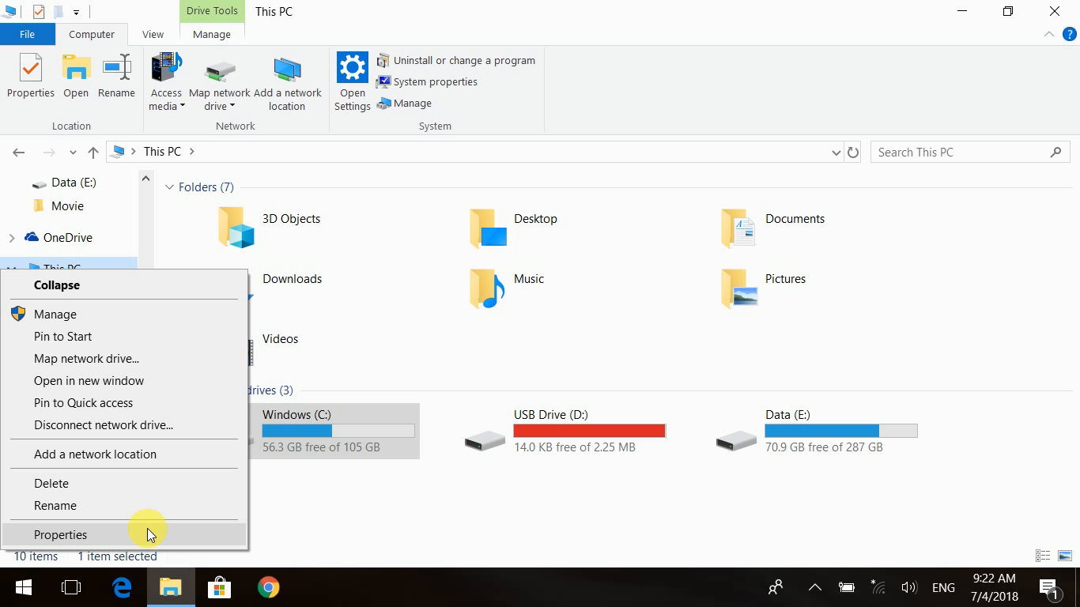
System Proterties

Slide 19
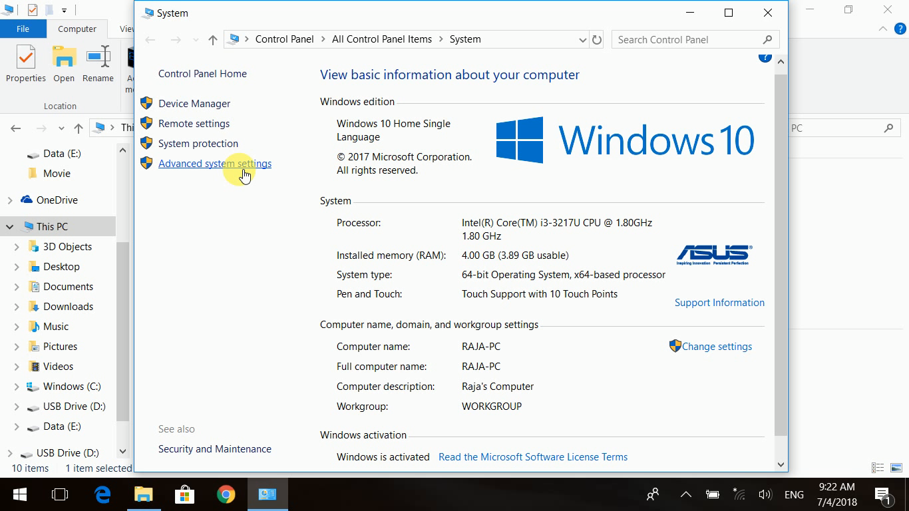
Advanced Settings

Slide 20
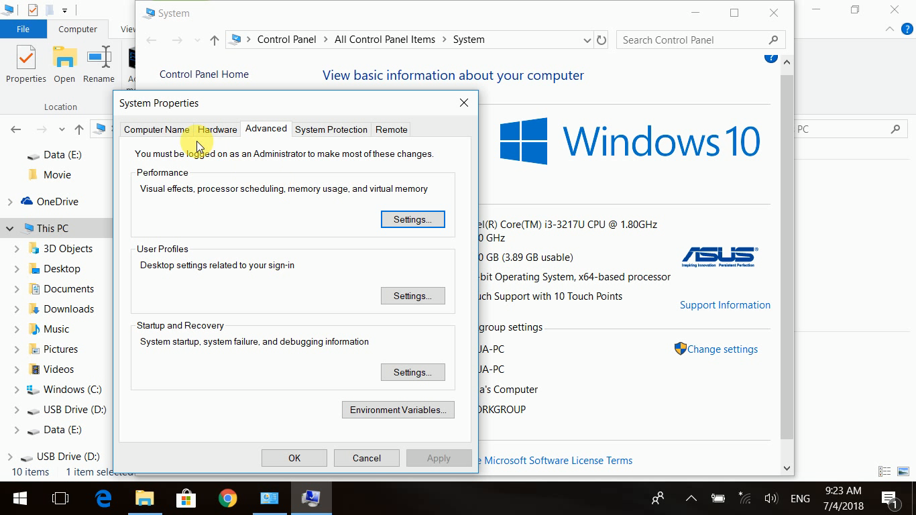
Advanced Tab

Slide 21
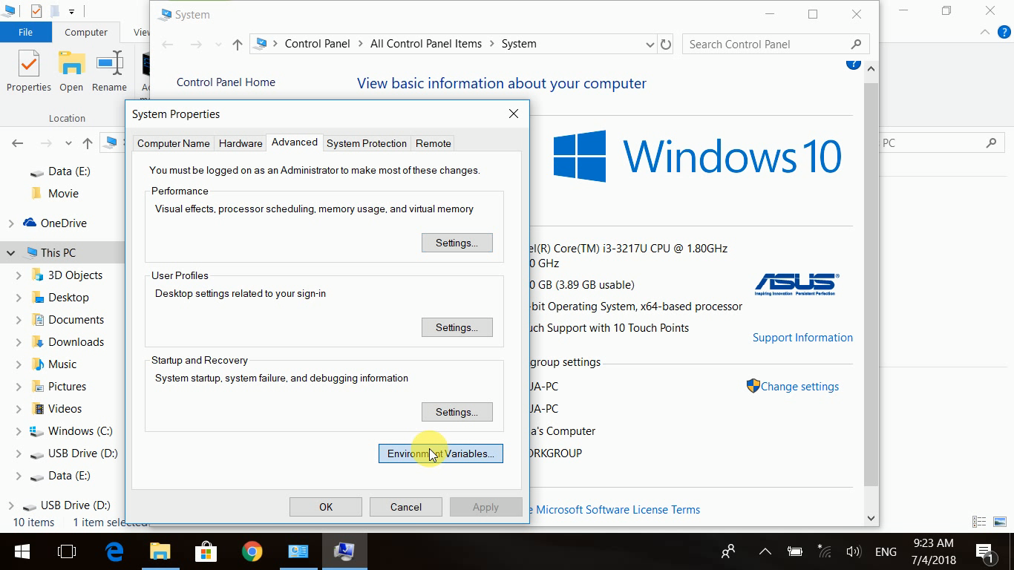
Click Enviroment Variables

Slide 22
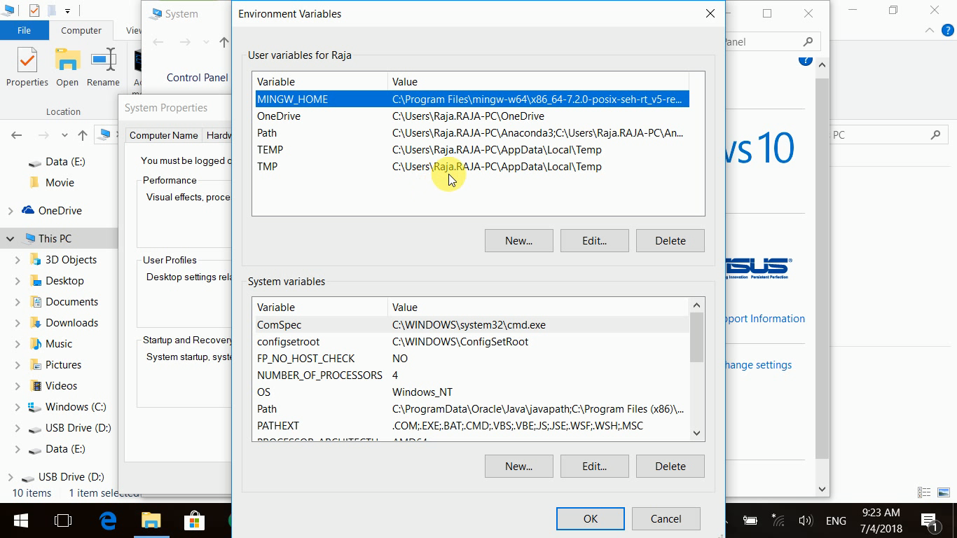
Find Path Variable

Slide 23
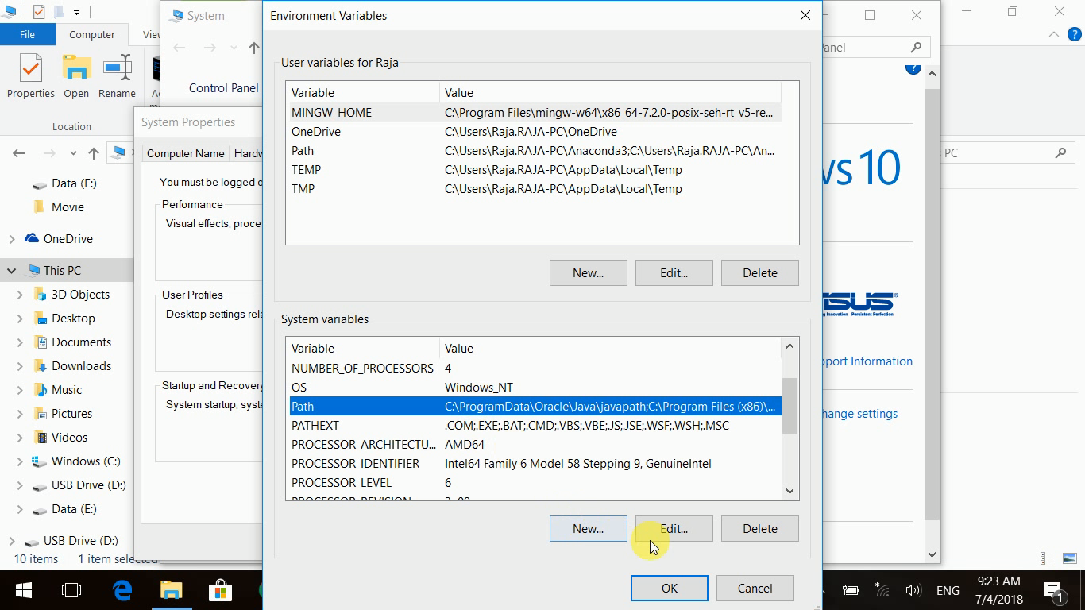
Path Found in System Variables

Slide 24
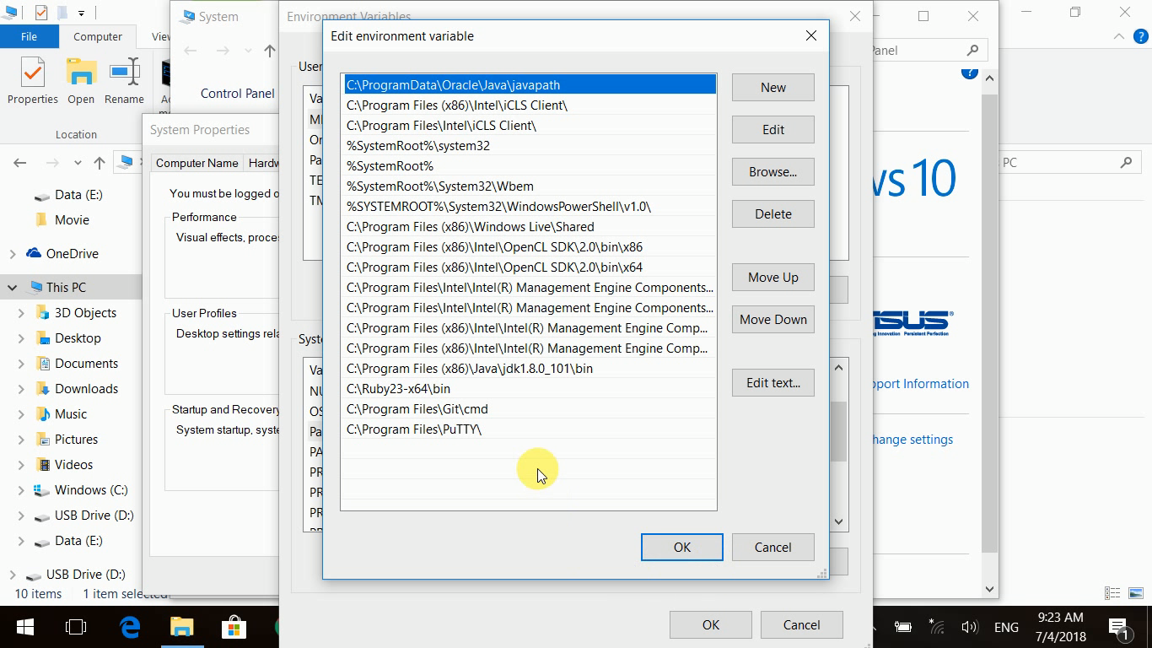
Let us understand this

Slide 25
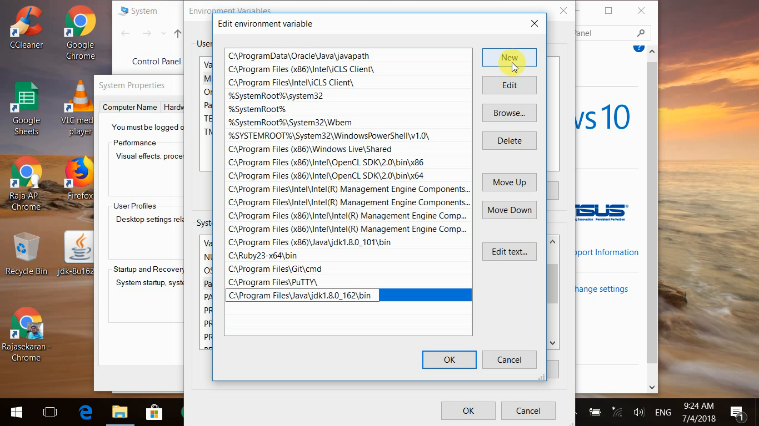
Adding Javapath to Path variable
C:\Program Files\Java\jdk1.8_162\bin

Slide 26
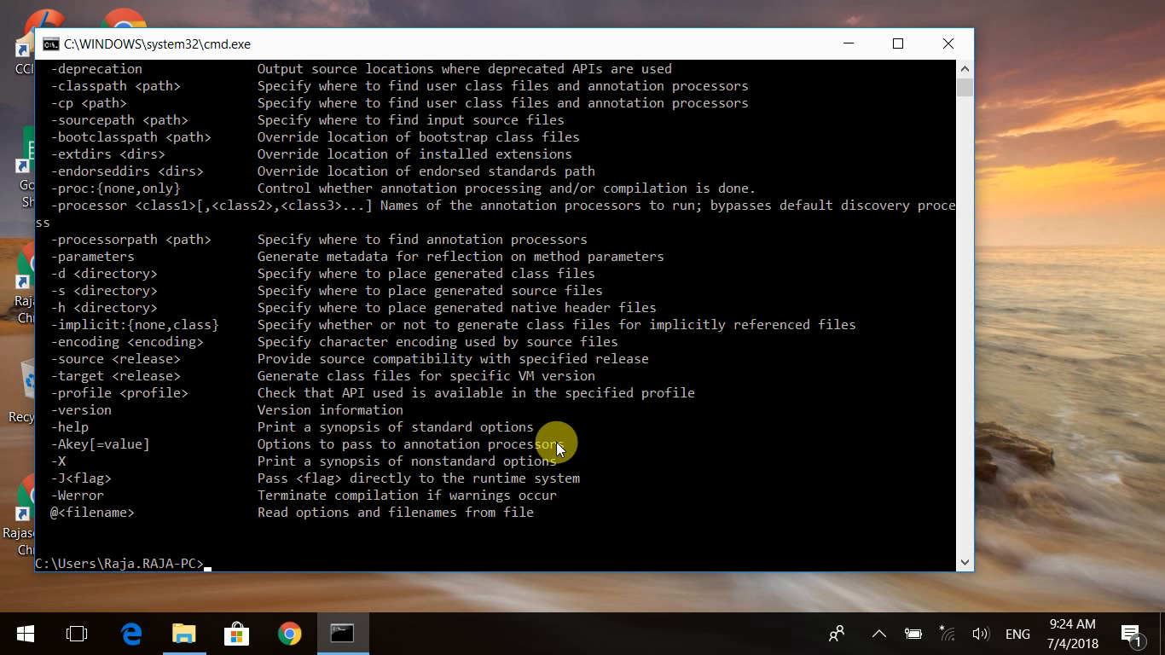
Now javac working
No need to do set path anymore
Your Java Enviroment up and ready for developement

Slide 27
Java Enviroment
Setting up Java Enviroment for Development
in
Linux OS

Slide 28
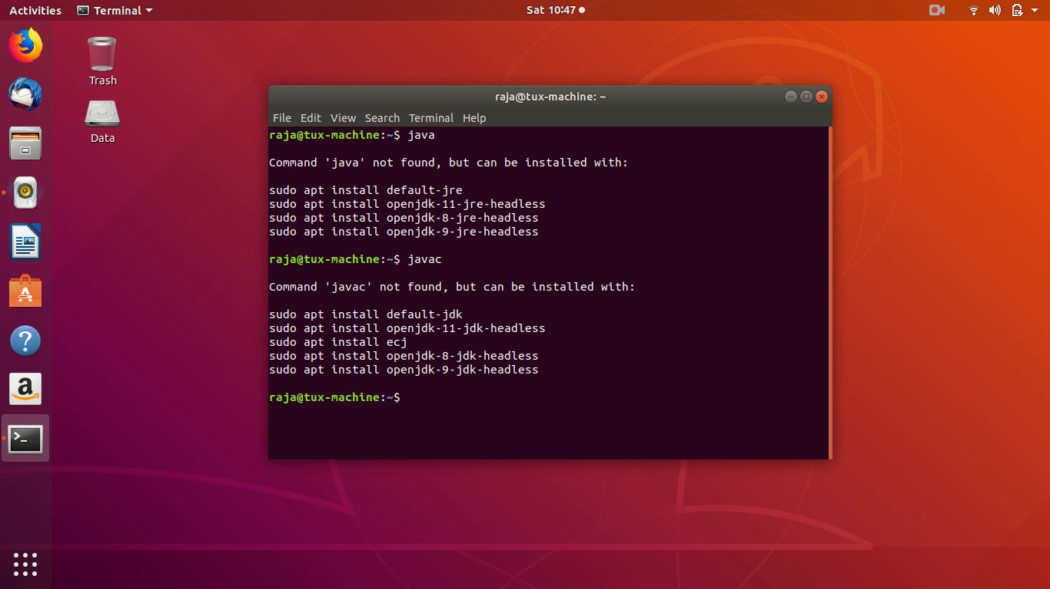
Checking for Java and Javac

Slide 29
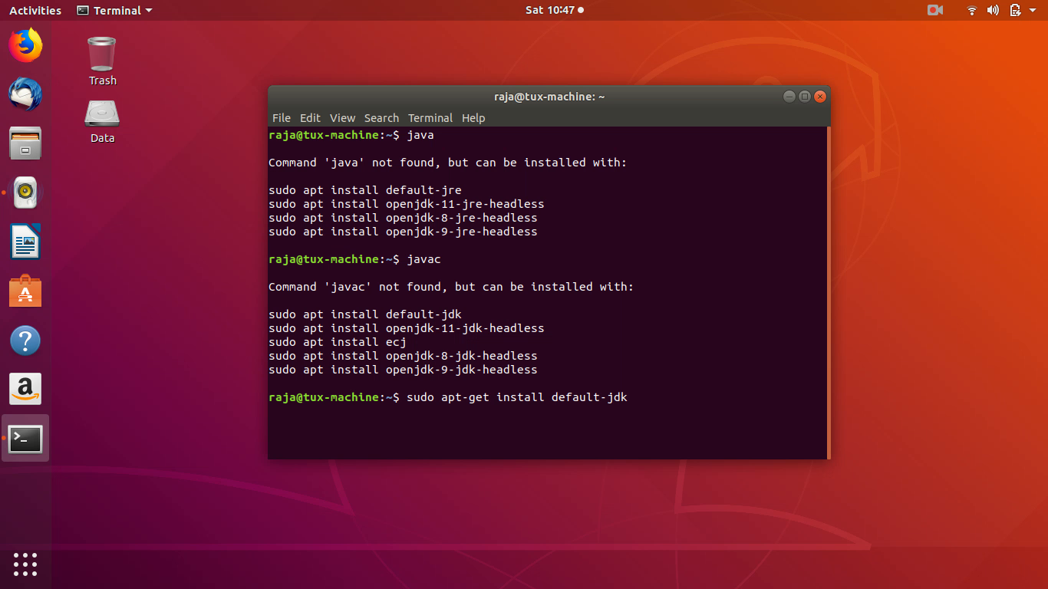
Running APT-GET
sudo apt-get install default-jdk

Slide 30
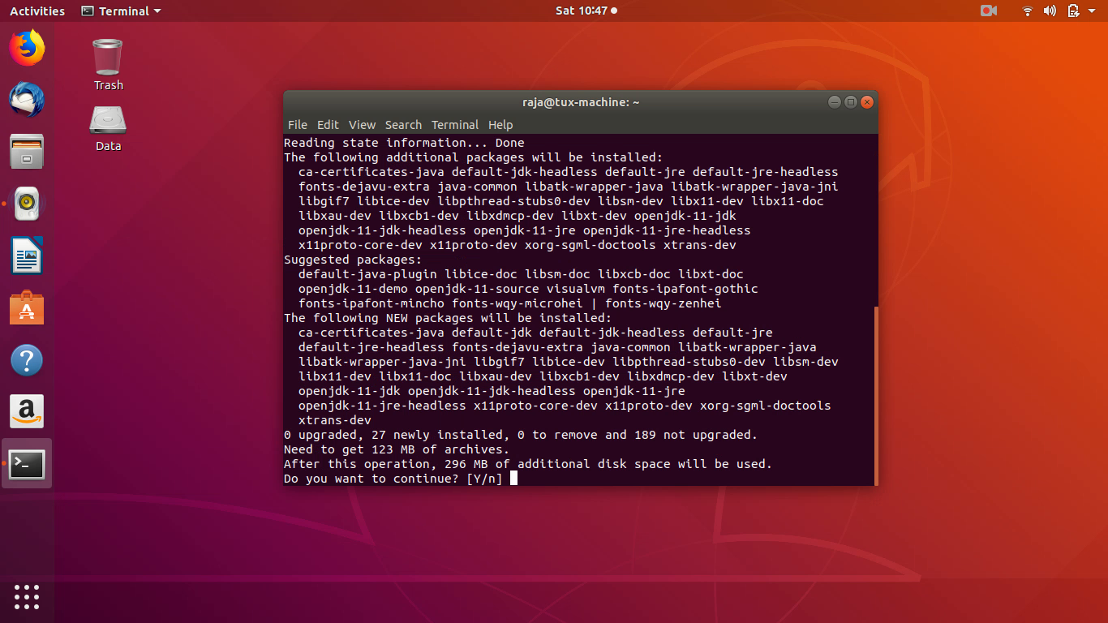
Dependancies and Permission to Install
Geive Yes = Y + Enter

Slide 31
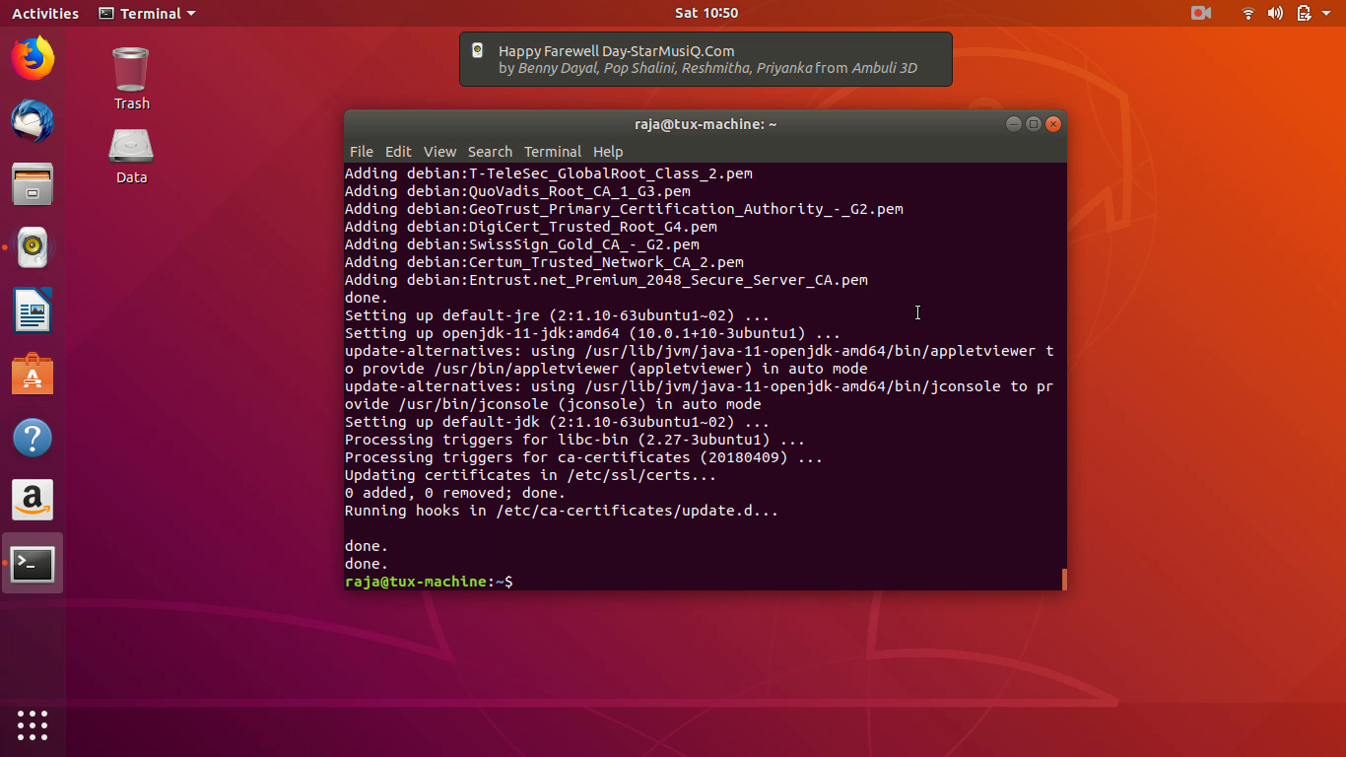
Installation Done

Slide 32
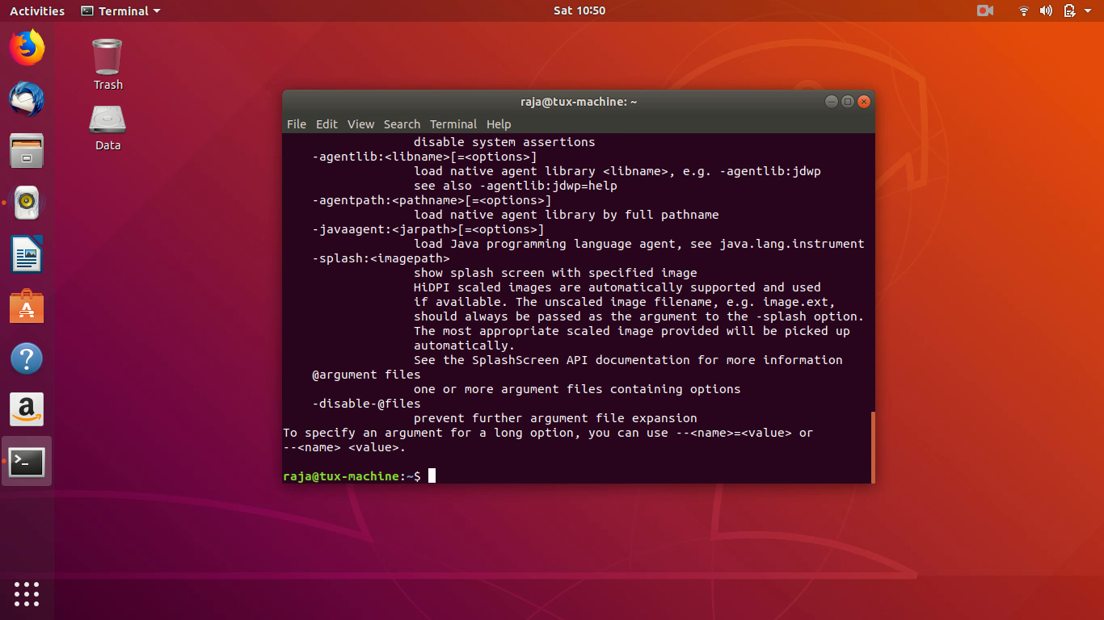
Checking for Java

Slide 33
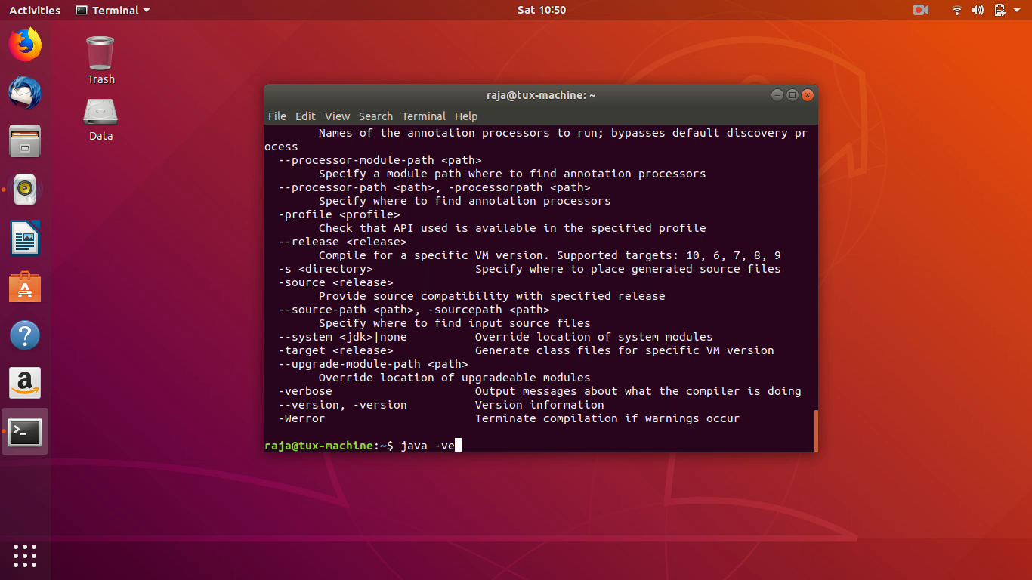
Checking for Javac

Slide 34
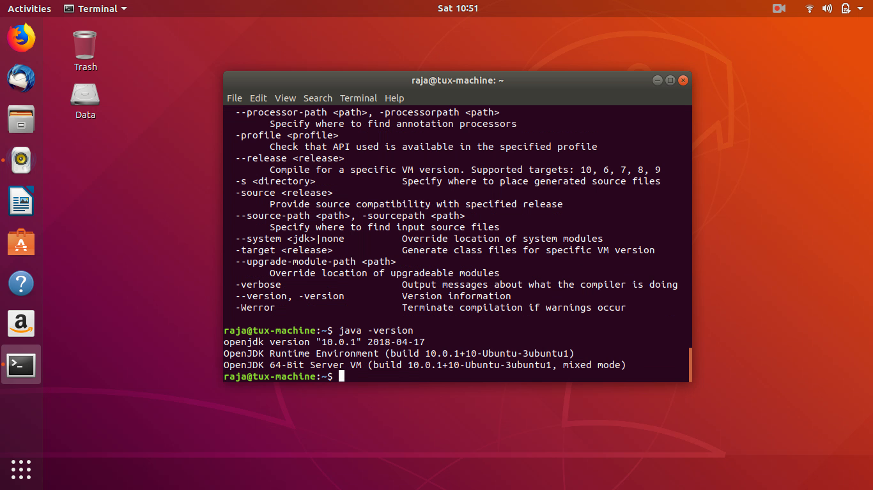
Checking for Java Version
We have Done !!!

Slide 35
Live Demo
Window OS
https://youtu.be/5FhWHTRtP8Q
Linux OS
https://youtu.be/XxQ_A-XSM_o

Slide 36
Thank You !!!
Rajasekaran S
AP/IT
KGISL Institute of Technology email:proffraja@gmail.com

